Slide 1
AI and Machine Learning Governance
Who Is Accountable When AI Fails?

Slide 2

Oops!
My bad.

Slide 3
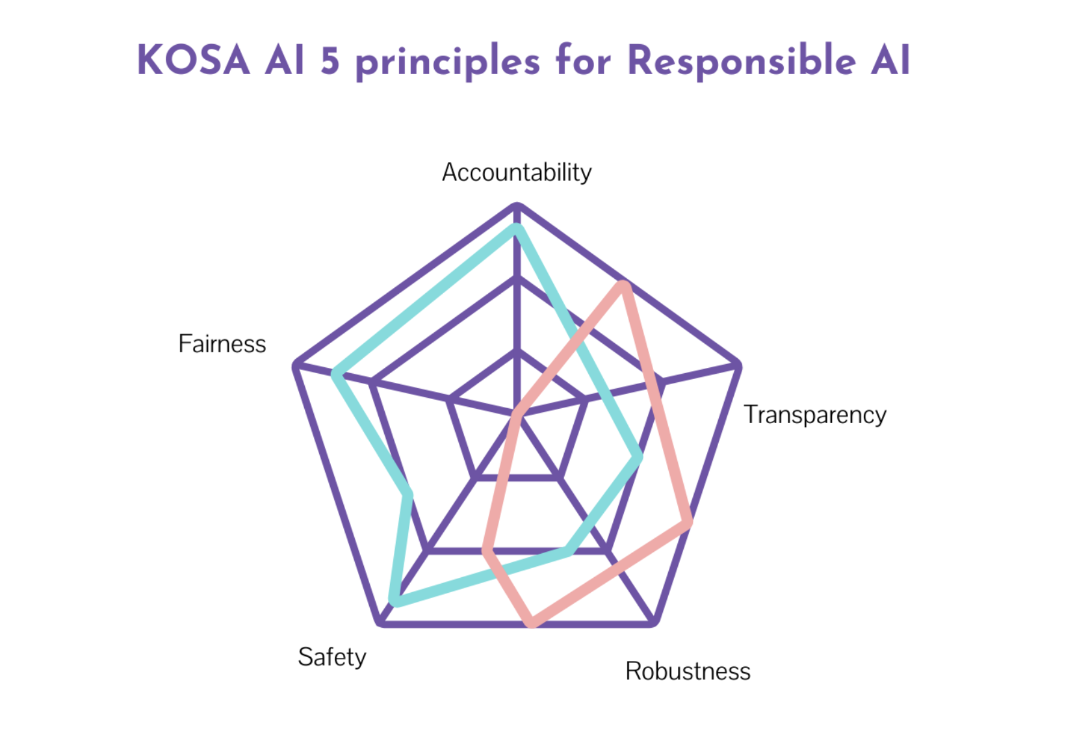

Slide 4
Difficulties with AI Governance Implementation
complexity of AI models and variety of tools used makes it difficult to standardize / audit them;
controlled lab environment vs. real-world environment;
coming up with metrics like biases, drifts, risks, anomalies can’t be solved in a lab;
security of the data used;
finding the balance between controlling undesirable risks and not stifling the technology;
lack of legal frameworks that establish liability for a machine

Slide 5
